Slide 1
Lecture 8
D&D Chapter 9 Inheritance

Slide 2
Goals
By the end of this lesson, you should
Understand the notation used in class diagrams
Know how to implement and use super and sub classes
Understand how to handle built-in exceptions with try-catch

Slide 3
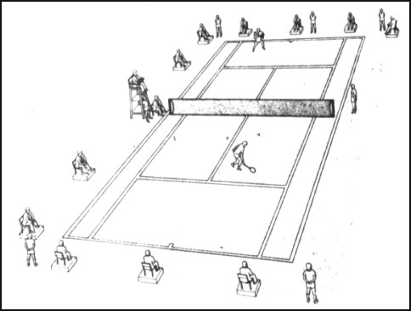
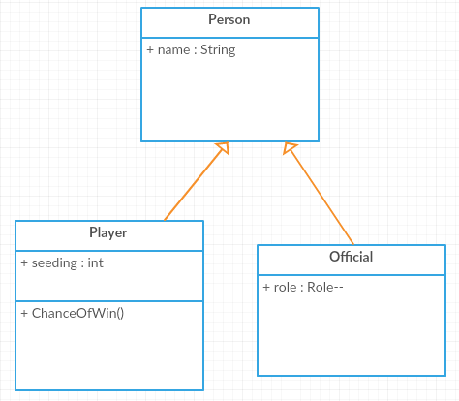
Tennis Tournament
Class diagrams
Superclass
Subclasses
Try-catch
Summary

Slide 4
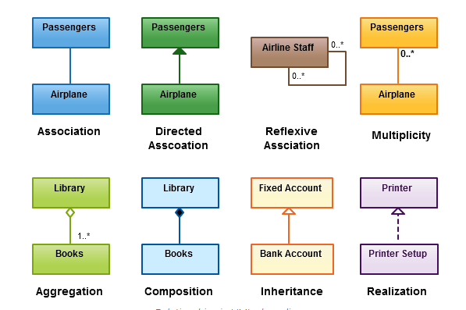
Class Diagram Basics
Class diagrams
Superclass
Subclasses
Try-catch
Summary
http://creately.com/blog/diagrams/class-diagram-relationships/

Slide 5
Person - Superclass
// Person.java
public class Person {
protected String name;
// constructors
public Person (){}
public Person (String name){
this.name = name;
}
// gets and sets
public void setName(String name){
this.name = name;
}
public String getName(){
return name;
}
//general methods
…
}
The Person superclass looks like any standard class except the variable name has been declared using the keyword protected rather than private. This means its private to this class and its subclasses.
Class diagrams
Superclass
Subclasses
Try-catch
Summary

Slide 6
Player - SubClass
Class diagrams
Superclass
Subclasses
Try-catch
Summary
//Player.java
public class Player extends Person {
private int seeding;
// constructors
public Player(String name) {
super(name);
}
public Player() {
super();
}
public Player(String name, int seeding){
super(name);
this.seeding = seeding;
}
// this class's gets and sets
public void setSeeding(int seeding){
this.seeding = seeding;
}
public int getSeeding(){
return seeding;
}
//methods
public int ChanceOfWin(){
return (int) (Math.random() *100)+1;
}
}
Player extends the Person class
The constructors must first call the superclass constructor (to ensure we have the Person-specific part of the object constructed). This constructor is referenced by super()
Player has the superclass fields and methods and its own

Slide 7
Official - SubClass
public class Official extends Person {
enum Roles {UMPIRE,LINEJUDGE,BALLKID,UNDEFINED};
private Roles role;
// constructors
public Official(String name) {
super(name);
}
public Official() {
super();
}
public Official(String name, String role){
super( name);
setRole(role);
}
// this class's gets and sets
public void setRole(String role){
try {
this.role = Roles.valueOf(role.toUpperCase());
}
catch (IllegalArgumentException e){
this.role = Roles.UNDEFINED;
}
}
public String getRole(){
return role.toString().substring(0,1).toUpperCase() + role.toString().substring(1).toLowerCase();
}
}
Class diagrams
Superclass
Subclasses
Try-catch
Summary
Official also extends Person

Slide 8
Official - SubClass
Class diagrams
Superclass
Subclasses
Try-catch
Summary
public class Official extends Person {
enum Roles {UMPIRE,LINEJUDGE,BALLKID,UNDEFINED};
private Roles role;
// constructors
…
// this class's gets and sets
public void setRole(String role){
try {
this.role = Roles.valueOf(role.toUpperCase());
}
catch (IllegalArgumentException e) {
this.role = Roles.UNDEFINED;
}
}
…
}
Note the use of an enum for the roles.
We also use exception handling here in the form of a try-catch block.
This is because the line in the try block will throw an exception (error) if the String role does not contain a valid value. The catch block allows us to take corrective action rather than letting the program crash.

Slide 9
Try-catch
Class diagrams
Superclass
Subclasses
Try-catch
Summary
public void setRole(String role){ try {
this.role = Roles.valueOf(role.toUpperCase()); }
catch (IllegalArgumentException e) { this.role = Roles.UNDEFINED; }
}
Many things can throw an exception: from a USB drive being removed in the middle of a save, to a divide-by-zero.
Trying to assign an invalid enum causes an exception.
Putting a try {} around code that may cause an exception will mean you can catch the exception and deal with it so that the program does not crash. (Obviously in a real program, you would have to get a valid role from the user.)
More about Exceptions later!

Slide 10
Inheritance Test
public class InheritanceTest {
public static void main(String[] args) {
Person superWoman = new Person();
superWoman.name = "Test Super Name";
System.out.println("name: " + superWoman.getName());
Player player1 = new Player();
player1.name = "Andy Murray";
player1.setSeeding(1);
System.out.printf("name: %s, seeding: %d chance of win %d %%\n", player1.getName(), player1.getSeeding(), player1.ChanceOfWin());
Player player2 = new Player("Angelique Kerber",1);
System.out.printf("name: %s, seeding: %d\n", player2.getName(), player2.getSeeding());
Official official1 = new Official("Kader Nouni","umpire");
System.out.printf("name: %s, role: %s\n", official1.getName(), official1.getRole());
Official official2 = new Official("Jilly BallGirl", "BallGirl");
System.out.printf("name: %s, role: %s\n", official2.getName(), official2.getRole());
}
}
Class diagrams
Superclass
Subclasses
Try-catch
Summary
Putting main() into a test class that runs a number of tests is a good way to try out these techniques and check they are working correctly

Slide 11
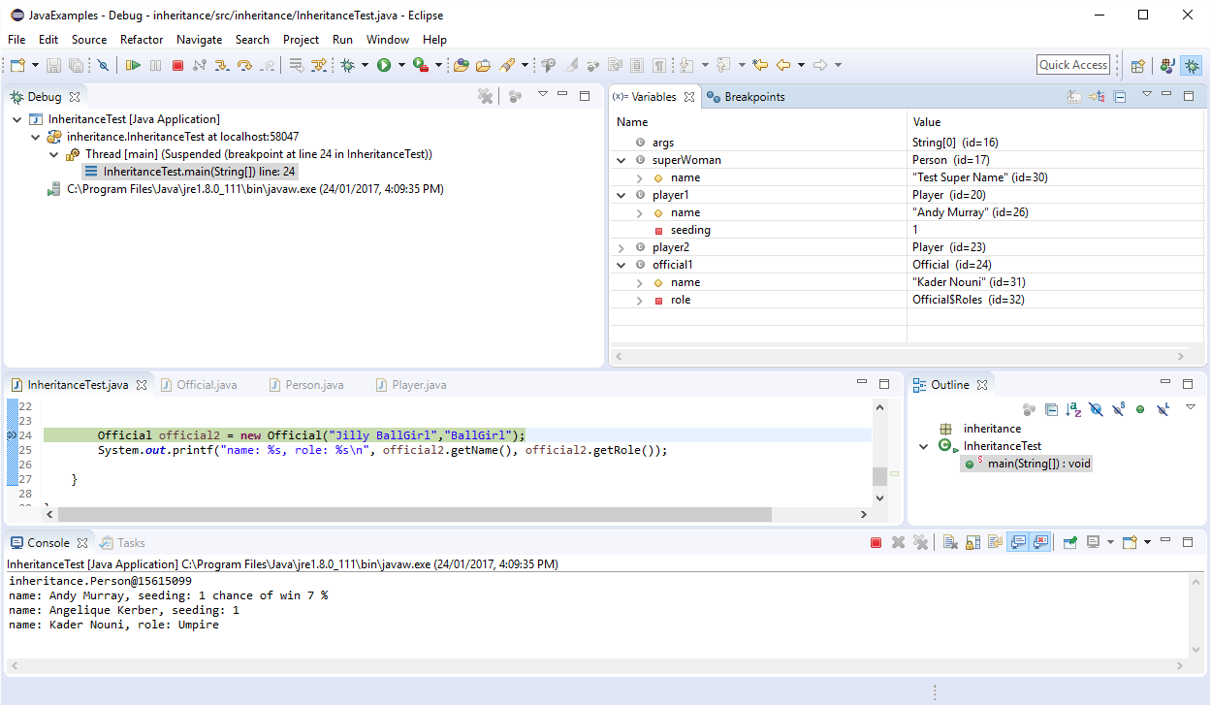
Debug
Class diagrams
Superclass
Subclasses
Try-catch
Summary

Slide 12
What do we know
Class diagrams
Superclass
Subclasses
Try-catch
Summary
Inheritance is when a class is used as the parent of another class
A super class is one which is used as a parent.
It can be exactly the same as any other class
The sub-class extends the super class
Add the keyword extends and the superclass name after the subclass class name. E.g.: public class Tomato extends Vegetable{ ..}
Subclass constructors must call the super class constructor as the first line of code.
The subclass has all the attributes, methods, types of the super class plus any new ones it declares
Sub-classes can also be super classes. There is no practical limit to the depth of the inheritance hierarchy.
A class can only extend one other class. See next lecture for how to achieve polymorphism (which lets a class inherit from multiple sources).

Slide 13
Resources
Class diagrams
Superclass
Subclasses
Try-catch
Summary
Composite classes
D&D chapter 8
https://docs.oracle.com/javase/tutorial/java/javaOO/
enums
D&D sections 5.8 and 8.9
https://docs.oracle.com/javase/tutorial/java/javaOO/enum.html

Slide 14
Next Lecture
D&D Chapters 10
Objects (4) Polymorphism

